Slide 1
CLASSROOM
JEOPARDY
TEAM EDITION

Slide 2
Classroom Jeopardy
World War
2
The
1980’s
“KISS”
The Music
Alabama
Grad Exam
American
Literature
AETC
100
100
100
100
100
100
200
200
200
200
200
200
300
300
300
300
300
300
400
400
400
400
400
400
500
500
500
500
500
500
FINAL JEOPARDY
QUIT
TEAMS

Slide 3
TEAMS

Slide 4
World War II - 100
Identify the three countries that made up the Allies.
Identify the three countries that made up the
Axis Powers.
Allies: Russia, United States, Great Britain Axis: Germany, Japan, Italy
ANSWER

Slide 5
World War II - 200
Identify two of the three leaders of the Axis Powers
Identify two of the three leaders of the Allied Powers
Allied: Roosevelt, Churchill, Stalin
Axis:Adolf Hitler, Benito Mussolini, HiroHito.
ANSWER

Slide 6
World War II - 300
The two cities in Japan that suffered destruction from the Atomic Bomb in 1945 – thus ending WW2.
Nagasaki and Hiroshima
ANSWER

Slide 7
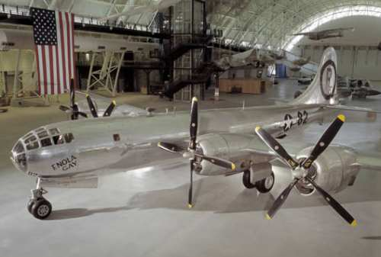
World War II - 400
The name of the plane that dropped the Atomic Bomb on Japan
Enola Gay
ANSWER

Slide 8
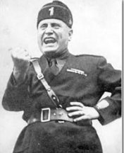
World War II - 500
Who is this person?
Benito Mussolini
ANSWER

Slide 9
The 1980’s - 100
Question
ANSWER
ANSWER

Slide 10
The 1980’s - 200
Question
ANSWER
ANSWER

Slide 11
The 1980’s - 300
Question
ANSWER
ANSWER

Slide 12
The 1980’s - 400
Question
ANSWER
ANSWER

Slide 13
The 1980’s - 500
Question
ANSWER
ANSWER

Slide 14
Alabama Grad Exam - 100
Question
ANSWER
ANSWER

Slide 15
Alabama Grad Exam - 200
Question
ANSWER
ANSWER

Slide 16
Alabama Grad Exam - 300
Question
ANSWER
ANSWER

Slide 17
Alabama Grad Exam - 400
Question
ANSWER
ANSWER

Slide 18
Alabama Grad Exam - 500
Question
ANSWER
ANSWER

Slide 19
“KISS” the Music - 100
The artist who wrote and sang the 80’s classic song – “KISS”
Who Is PRINCE
ANSWER

Slide 20
“KISS” the Music - 200
Two of the individuals that created the band KISS, and have been the only two consistent band members for forty years.
Who are Paul Stanley and Gene Simmons
ANSWER

Slide 21
“KISS” the Music - 300
Question
ANSWER
ANSWER

Slide 22
“KISS” the Music - 400
Question
ANSWER
ANSWER

Slide 23
“KISS” the Music - 500
Question
ANSWER
ANSWER

Slide 24
American Literature - 100
Question
ANSWER
ANSWER

Slide 25
American Literature - 200
Question
ANSWER
ANSWER

Slide 26
American Literature - 300
Question
ANSWER
ANSWER

Slide 27
American Literature - 400
Question
ANSWER
ANSWER

Slide 28
American Literature - 500
Question
ANSWER
ANSWER

Slide 29
AETC - 100
Question
ANSWER
ANSWER

Slide 30
AETC - 200
Question
ANSWER
ANSWER

Slide 31
AETC - 300
Question
ANSWER
ANSWER

Slide 32
AETC - 400
Question
ANSWER
ANSWER

Slide 33
AETC - 500
Question
ANSWER
ANSWER

Slide 34
FINAL JEOPARDY
Category: GEOGRAPHY
Identify the FIVE states that border the Pacific Ocean…
California, Oregon, Washington, Hawaii, and Alaska
QUESTION
ANSWER

Slide 35
Backup for smaller squares
100
200
300
400
500

Slide 36
SAMPLE TEMPLATE
QUESTION:
Clear this out and type your question….
ANSWER
ANSWER

