Slide 1
Colors

Slide 2
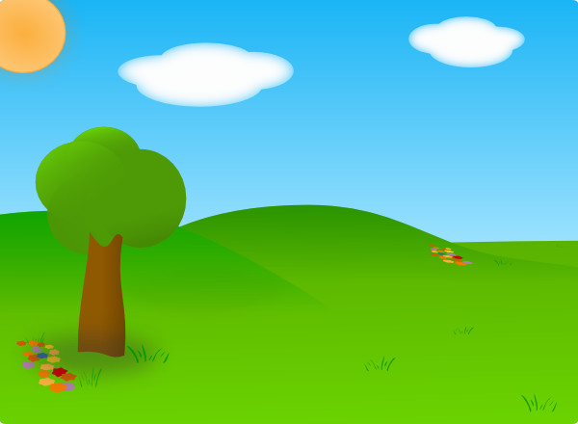
There is YELLOW like the sun
sun

Slide 3
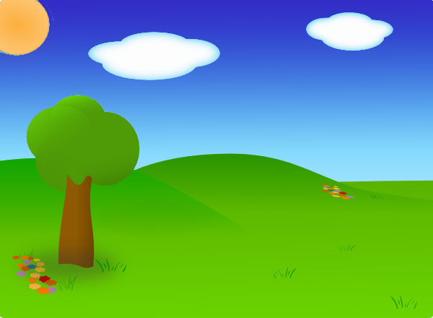
There is BLUE like the sky.
SKY

Slide 4
My favorite color is PINK,
what is yours?
Flower

Slide 5
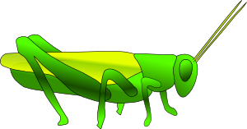
There is GREEN like grasshoppers
grasshopper

Slide 6
There is WHITE like the clouds
clouds

Slide 7
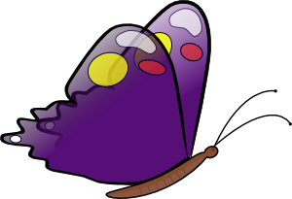
There is PURPLE like a butterfly.
Purple

Slide 8
There is RED like roses.
rose

Slide 9
There is BLACK like the night sky
night
day

Slide 10
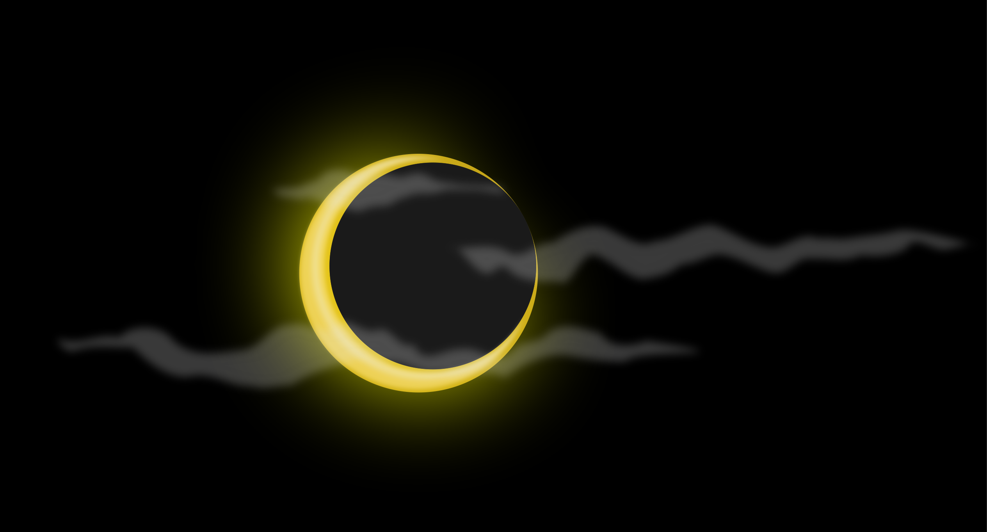
There is black like the night sky
day
night
day

Slide 11
There is ORANGE like oranges
oranges

Slide 12
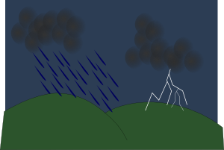
There is GREY like rain clouds.
Rain clouds
Sunshine

Slide 13
Colors make the world bright ☺

