Slide 1
DOMINICA
Carli Culpepper

Slide 2
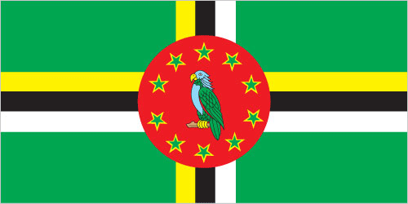
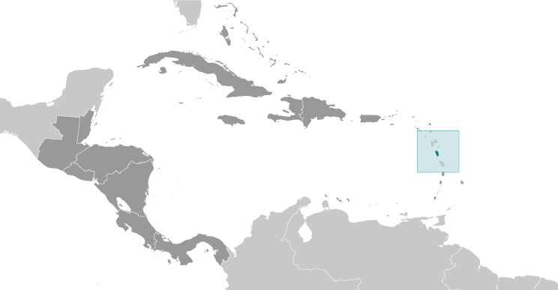
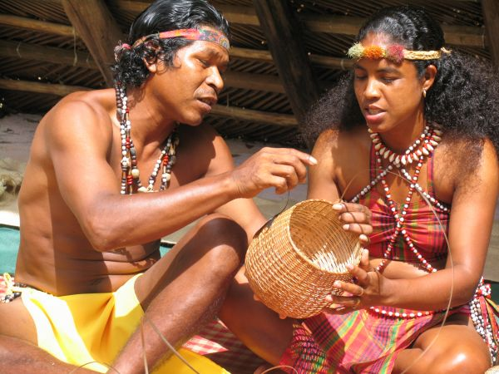
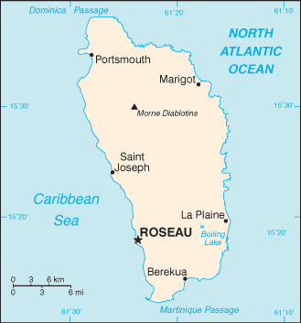
Introduction
Dominica was the last of the Caribbean islands to be colonized by Europeans due chiefly to the resistance of the native Caribs. France ceded possession to Great Britain in 1763, which made the island a colony in 1805. Dominica gained its independence in 1978 on November 3rd.
Some 3,000 Carib Indians still living on Dominica are the only pre-Columbian population remaining in the eastern Caribbean. (Kalinago people) – Link (http://kalinagoterritory.com/)

Slide 3
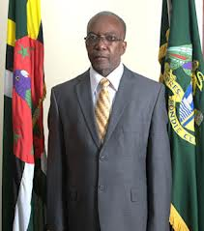
Government
Type of Government: Parliamentary Democracy
President: Eliud T. Williams
(President elected by the House of Assembly for a five-year term; prime minister appointed by the president).
National Anthem:
"Isle of Beauty"
Capitol: Roseau
Largest City: Roseau (16,571)
Click to Play Anthem
lyrics/music: Wilfred Oscar Morgan POND/Lemuel McPherson CHRISTIAN
note: adopted 1967

Slide 4
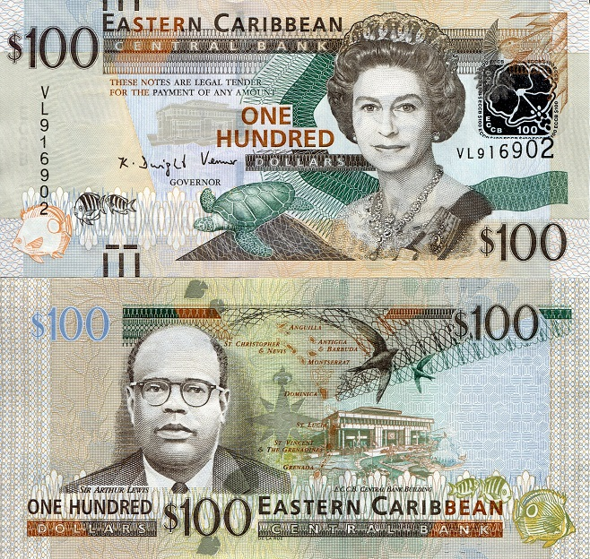
Currency
Internet Country Code: .DM
1 USD = 2.70 XCD (East Caribbean Dollars)
1
2

Slide 5
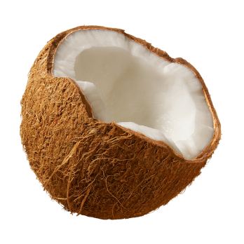
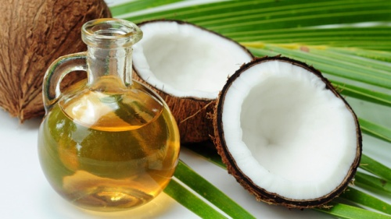
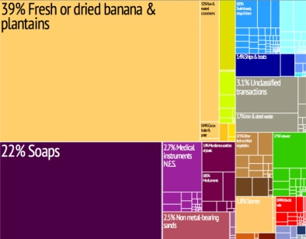
Economy
Natural Resources: Soap, Coconut Oil, Tourism, Copra, Furniture, and Shoes
Exports: Bananas, Soap, Bay Oil, Vegetables, Grapefruit, Oranges
Annual Income Average: $7,090
Export Tree Map

Slide 6
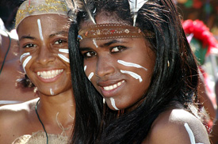
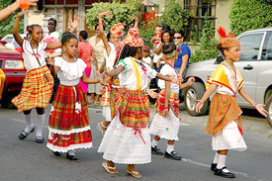
People & Culture
Language: English (official), French patois
Life Expectancy: 76.39 years - (Male: 73.43; Female: 79.49)
Population: 73,286 (July 2013 est.)
Unemployment: 23%
Religions:
Roman Catholic 61.4%
Protestant 20.6%
other Christian 7.7%

Slide 7
National Issues/Concerns
Transshipment point for narcotics bound for the US and Europe (Drug Trafficking).
Dominica is a minor cannabis producer.
Government’s inability to effectively reduce poverty levels and jumpstart the economy is no incentive for developers or local investors.
Climate change impacts on natural resources and infrastructure is sending Dominica deeper into poverty.
Unemployment and unskilled workforce.

Slide 8
Bibliography
Cover Image (Dominica): http://www.high-net-worth-immigration.com/Portals/138426/images/roseau-dominica-news-online.jpg
Currency (image): http://www.thesquirrel.nl/index.php?manufacturers_id=223&osCsid=1inqph8vf9d84fcvhaphc3ub82
Country information: https://www.cia.gov/library/publications/the-world-factbook/geos/do.html
Country Background: http://en.wikipedia.org/wiki/Dominica#Education
Coat of Arms: http://en.wikipedia.org/wiki/File:Dominica-arms.PNG
Carib’s Image: http://www.antiguaobserver.com/indigenous-people-want-territory-re-named/
Presidential picture: http://presidentoffice.gov.dm/
Population: http://www.geonames.org/DM/largest-cities-in-dominica.html
Annual Salary: http://www.doingbusiness.org/data/exploreeconomies/dominica/
National Concerns/Issues Report: http://www.sids2014.org/content/documents/21Dominican%20Republic-National%20Report.pdf
Dominica Culture and Heritage: http://searchdominica.com/destinations/culture-heritage
Copra image: http://www.handmademen.com/smooth-shaving-tips/
Coconut Oil graphic: http://foodmatters.tv/articles-1/10-great-reasons-you-should-be-using-coconut-oil
Kalinago People – http://kalinagoterritory.com
Dominica Export Map: http://en.wikipedia.org/wiki/File:Tree_map_export_2009_Dominica.jpeg

Slide 9
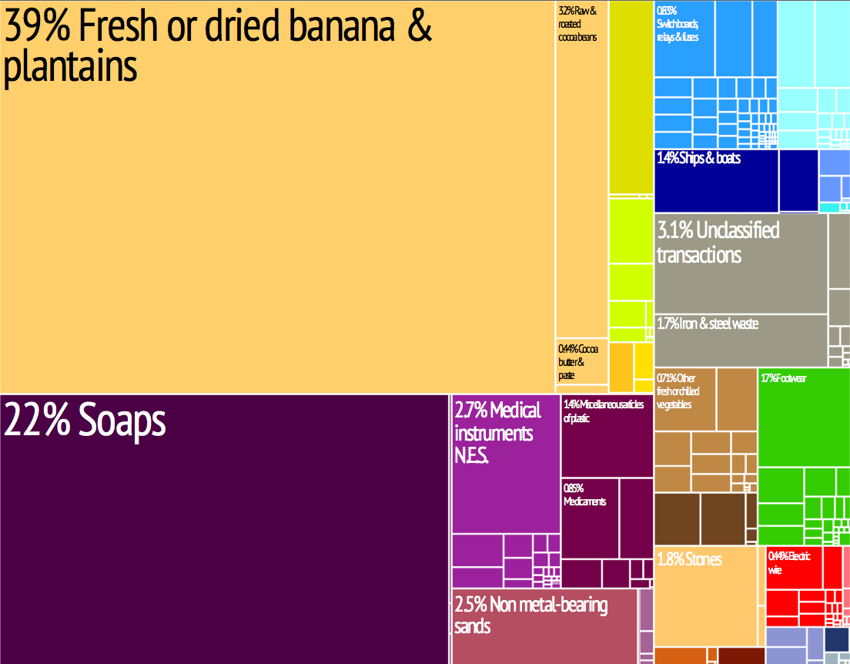
Export Tree Map
Back to Economy

