Slide 1
Touch Areas of the Screen To
Find the Fun!
Things We Learn At The Farm

Slide 2
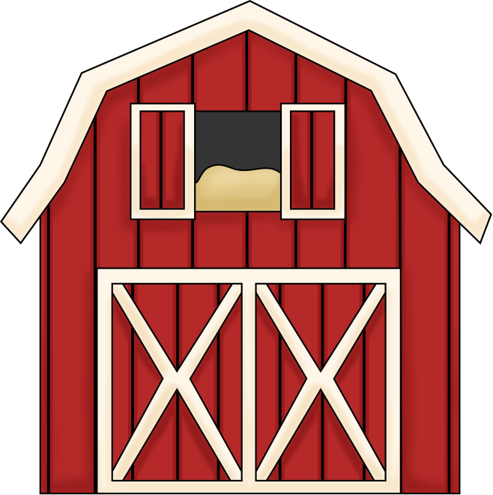
COW
Where is Chick-Fil-A?
What Does A Cow Say?
END

Slide 3
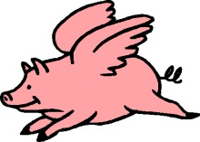
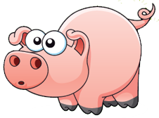
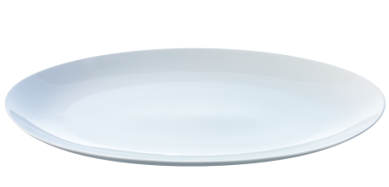
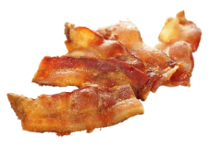
Don’t Eat
Bacon!
What Does A PIG Say?
END

Slide 4
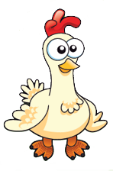
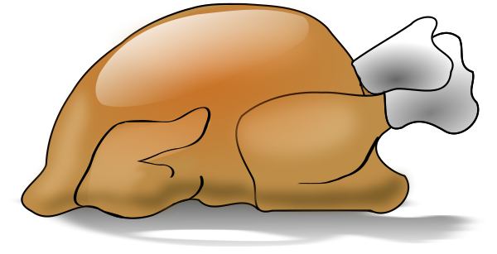
I hate Thanksgiving season
What Does A TURKEY Say?

Slide 5
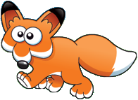
Ring-ding-ding-ding-dingeringe-ding!
END
What Does A Fox Say?

Slide 6
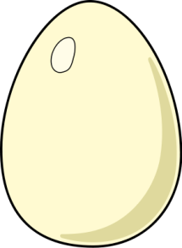
END
What Does A Chicken Say?

