Slide 1
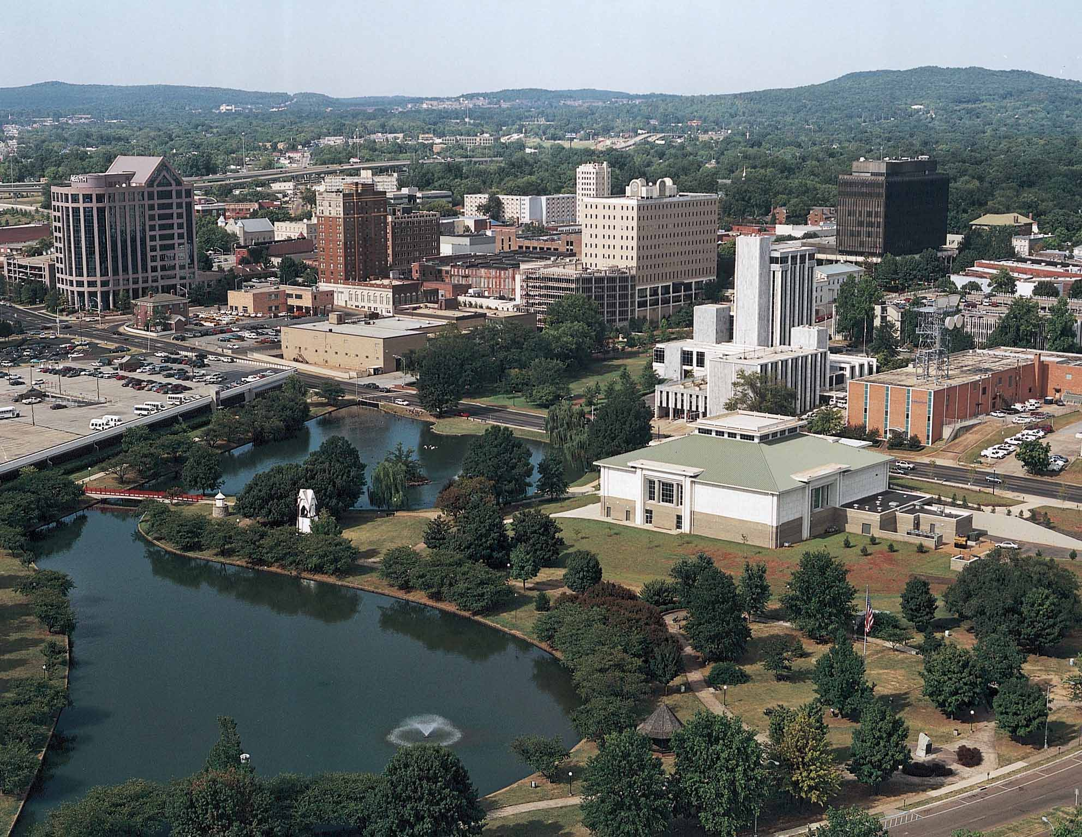
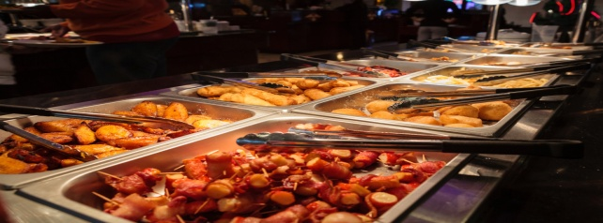
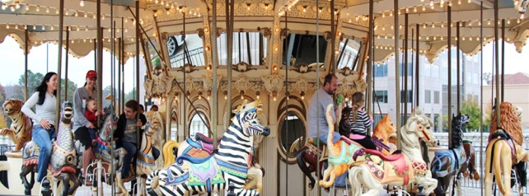
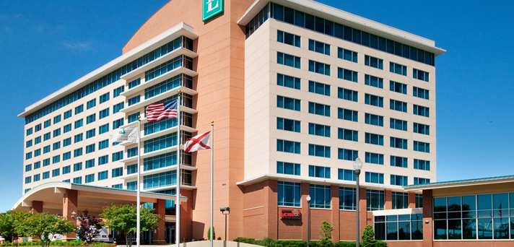
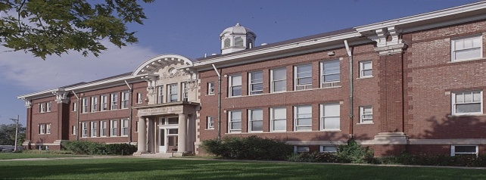
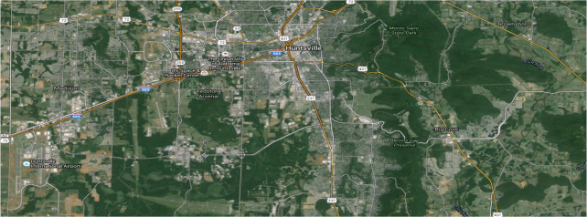
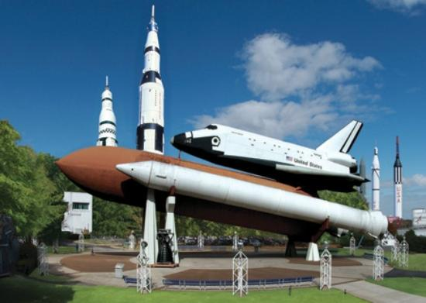
Huntsville, AL
Dining
Entertainment
Shopping
Schools
Satellite Image
Area Information

Slide 2



Shopping
Parkway Place Mall | (Link)
2801 Memorial Park South
Huntsville, AL 35801
Phone: 256.533.9094
Madison Square Mall | (Link)
Address: 5901 University Dr, Huntsville, AL 35806
Phone:(256) 837-0670
Bridge Street Town Centre (Link)
365 The Bridge Street, Suite 106
Huntsville, AL 35806
Phone: 256-327-8400

Slide 3


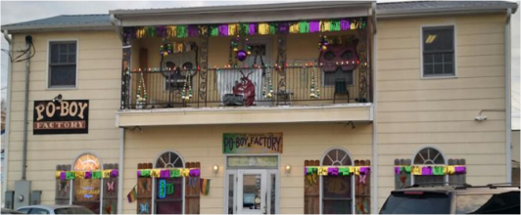
Dining
Red RobIN (LINK)
PHONE: (256) 327-8530
365 The Bridge Street, Suite 117
Huntsville, AL
P.F. Changs (Link)
Phone: (256) 327-8320
305 The Bridge Street, Suite 101
Huntsville, AL
Po Boy Factory | LINK
815 Andrew Jackson Way NE,
Huntsville, AL 35801
(256) 539-3616

Slide 4
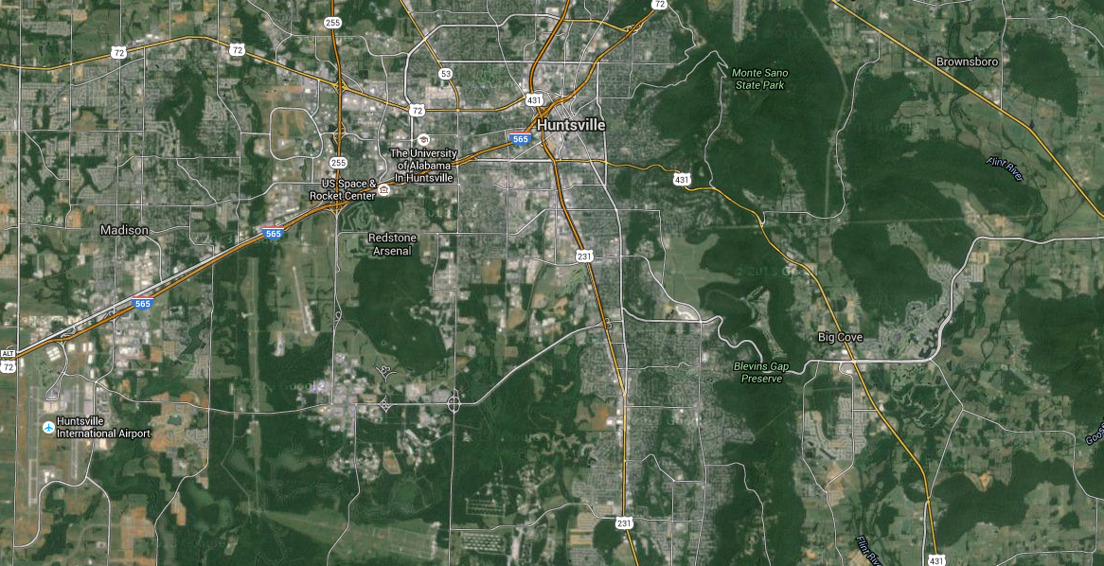
Satellite Image

Slide 5


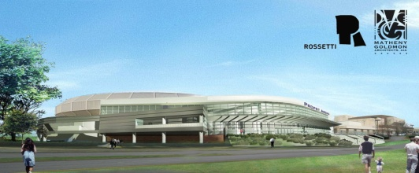
Entertainment
Space & Rocket Center| LINK
1 Tranquility Base, Huntsville, AL 35805
(256) 837-3400
Hours: 9:00 AM – 5:00 PM
Mount Sano State Park | LINK
5105 Nolen Ave.
Huntsville, AL 35801
(256)534-3757
Von Braun Center | Link
700 Monroe Street
Huntsville, Alabama 35801
Phone: 256.533.1953
Huntsville City Calendar of Events

Slide 6
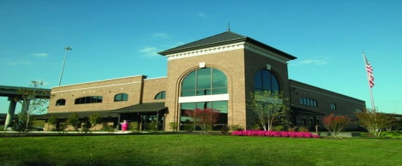
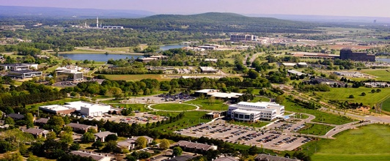
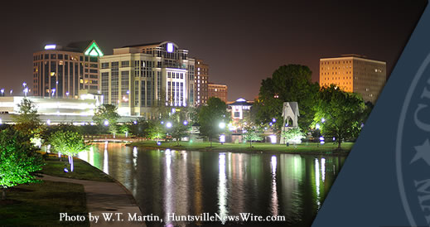
Area Information
Huntsville/Madison County Visitor Center | LINK
500 Church St NW, Huntsville, AL 35801
Phone: (256) 551-2230
Huntsville Chamber of Commerce | LINK
225 Church Street NW, Huntsville, Alabama 35801
Phone: (256) 535-2000
Huntsville City Government | LINK
Municipal Building-1st Floor
308 Fountain CircleHuntsville, AL 35801
256.427-5240

Slide 7



Schools
Huntsville City schools | link
200 White St SE, Huntsville, AL 35801
Phone: 256-428-7990
Madison City Schools | LINK
211 Celtic Dr, Madison, AL 35758
(256) 464-8370
University of Alabama – Huntsville | LINK
301 Sparkman Drive, Huntsville, AL 35899
256.824.1000

