Slide 1
ICELAND
Your Name

Slide 2
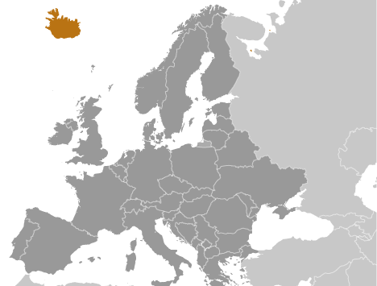
National
Settled by Norwegian and Celtic (Scottish and Irish) immigrants during the late 9th and 10th centuries A.D.
The second half of the 20th century saw substantial economic growth driven primarily by the fishing industry
Independence: June 17, 1944

Slide 3
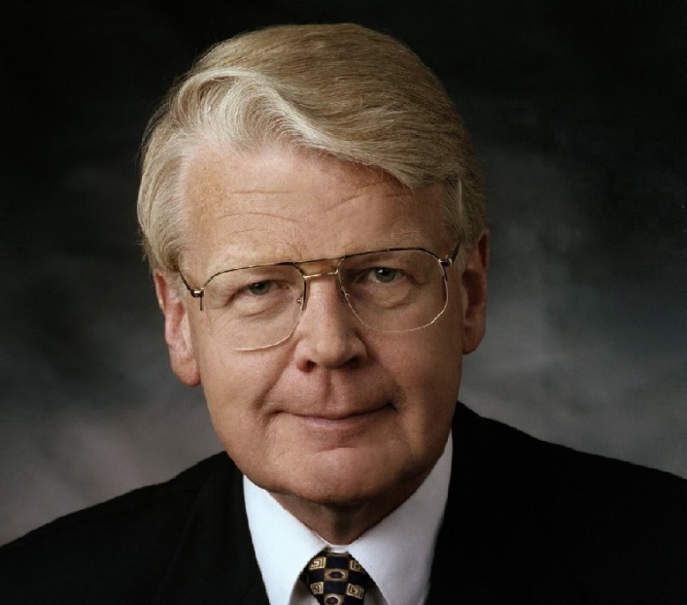
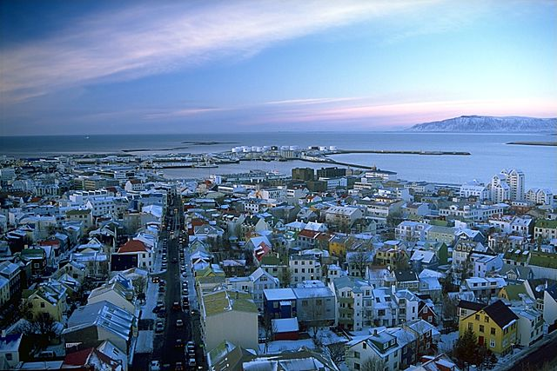
Government
President: Ratu Epeli NAILATIKAU
Rule: Popular Vote 4 Years
Government: Constitutional Republic
Largest City: Reykjavik
Capitol: Reykjavik
Anthem: O, God of Our Land
STOP

Slide 4
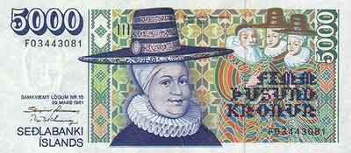
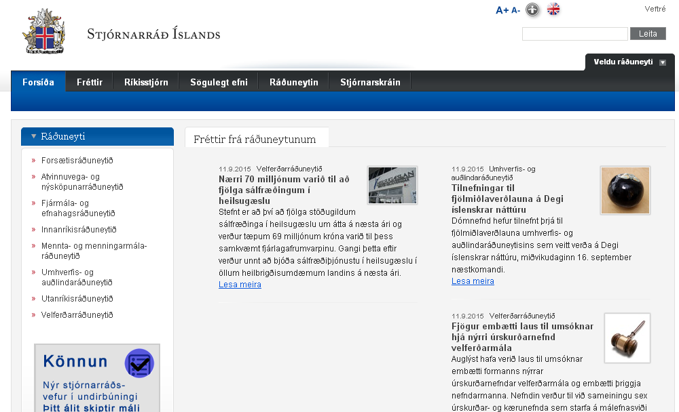
Currency
Name: Krona
Exchange Rate:
1.00 USD=128.53 ISK
National Website:
(Icelandic/Norsk)
Internet Code: .is

Slide 5
Resources
Imports: machinery and equipment, petroleum products, foodstuffs, textiles
Exports: fish and fish products, aluminum, animal products, ferrosilicon, diatomite
Natural Resources:
Environmental Issues:
fight against the pollution of the oceans.
Conservation of the environment is a high priority for Iceland, a country that depends on natural resources and their sustainable management.

Slide 6
People
Population: 331,918
Official Language: Icelandic, English, Nordic languages, German widely spoken
Religion(s): Evangelical Lutheran Church of Iceland (official) 73.8%, Roman Catholic 3.6%, Reykjavik Free Church 2.9%
Expected Life span: 82.97 yrs.
Nationality: Icelander(s), Icelandic
Unemployment: 13.6%
Obesity Factor: 23.9% (Ranked #76 in the world)

Slide 7
National Issues
Fight against the pollution of the oceans.
Conservation of the environment is a high priority for Iceland, a country that depends on natural resources and their sustainable management.

Slide 8
Bibliography
Background (Slide 1): https://upload.wikimedia.org/wikipedia/commons/e/e5/Iceland2008-Sudureyri.JPG
Content: https://www.cia.gov/library/publications/the-world-factbook/geos/fj.html
President: http://www.icefish.is/__data/assets/image/0009/996615/President-of-Iceland.jpg
City Picture: Reykjavic - https://en.wikipedia.org/wiki/Template:Largest_cities_of_Iceland
Krona: http://www.150currency.com/images/currency/ISK_banknotes.jpg
Exchange Rate: http://www.xe.com/currencyconverter/convert/?Amount=1&From=USD&To=ISK
Environment: http://www.iceland.is/the-big-picture/nature-environment/environment

