Slide 1
MAZE
Instructions
Don’t Stray off the Path.
Don’t Touch the Moving Obstacles.
= Start
= Yellow Dots Open Doors
= Exit/Next Level
Start

Slide 2
N
BLOCK
Click Yellow Spot To Remove Block
Y
LeveL 1
S

Slide 3
THE NEXT LEVEL
N
S

Slide 4
LeveL 3
NEXT LEVEL
Start
Click

Slide 5
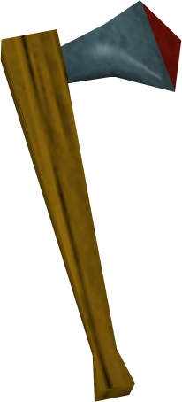
Start
END?

Slide 6
FAILURE!
RESTART

Slide 7
NOT TO SHABBY!
??

