Slide 1
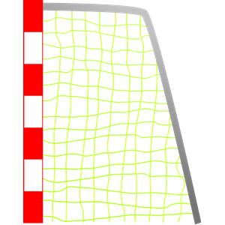
The Boy Who Loved
Soccer
BEGIN

Slide 2
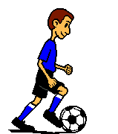
When Jose fell asleep at night, he dreamed about playing soccer.
Z
Z
Z
Z
Z
Is He Dreaming?

Slide 3
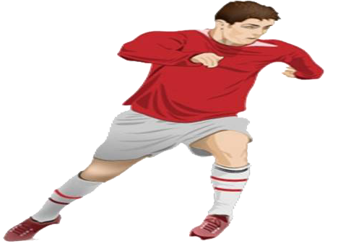
There once was a boy named Jose who lived in South America that loved to play soccer.
Kick the Ball

Slide 4
He played soccer everyday at school, at home, and even by himself.
Shake Tree
Shake Tree
Ball
Sun

Slide 5
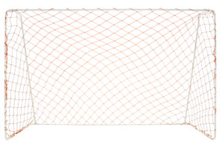
He even played soccer when it got dark.
He even played soccer when it got dark.
Run
Daytime
Nighttime

Slide 6
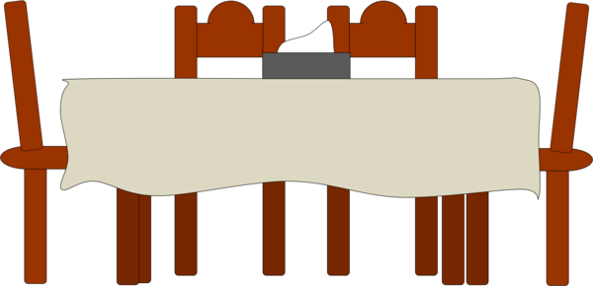
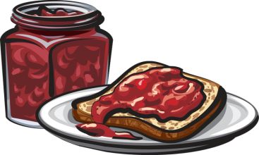
He practiced all the time. Sometimes, he practiced at the kitchen table during breakfast.
Ball

Slide 7
The funniest time was when he practiced in the snow. All you could see was the ball bouncing up and down
Ball

Slide 8
This E-Book was created by…
Kevin T. Culpepper
END STORY

