Slide 1
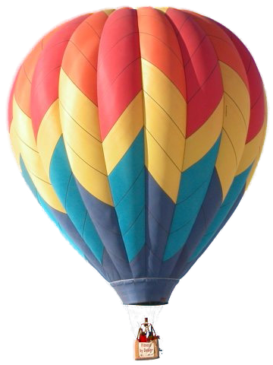
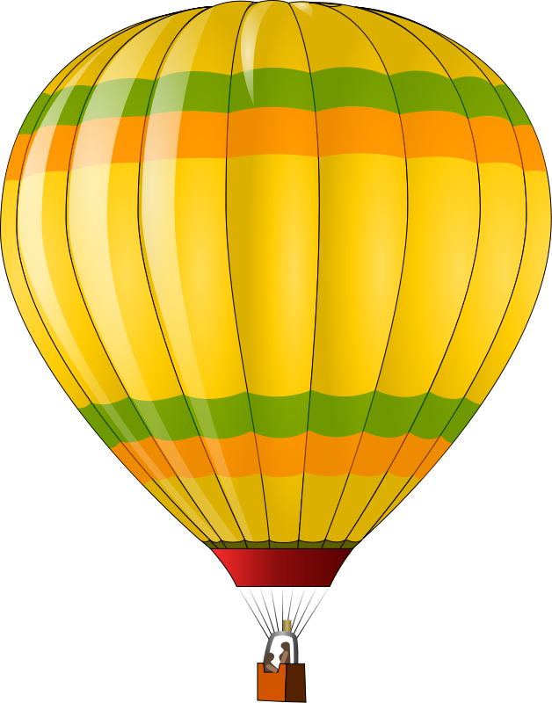
The Great Balloon Ride
END

Slide 2
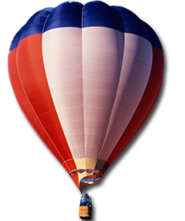
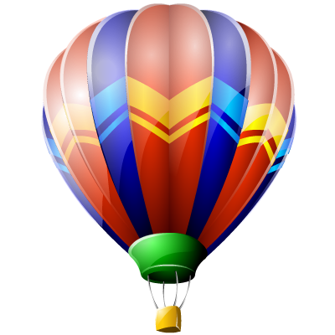
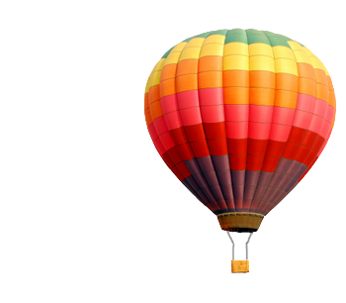
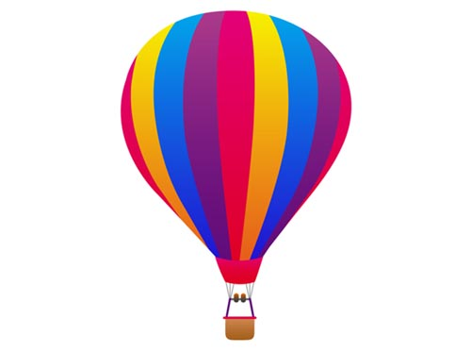
One of my favorite things I have ever done was to ride in a HOT AIR BALLOON.
E
N
D
UP, UP, & Away

Slide 3
My House
I was able to see my neighborhood and my house.
I was able to see my neighborhood and my house.
E
N
D

Slide 4
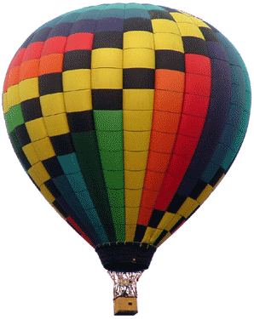
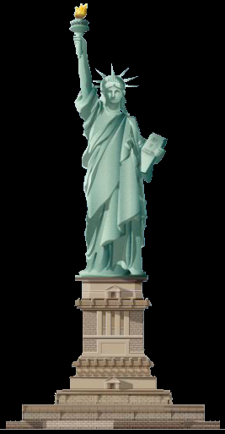
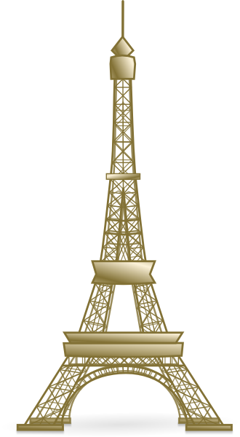
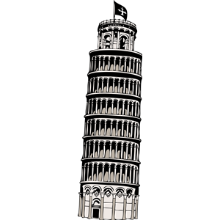
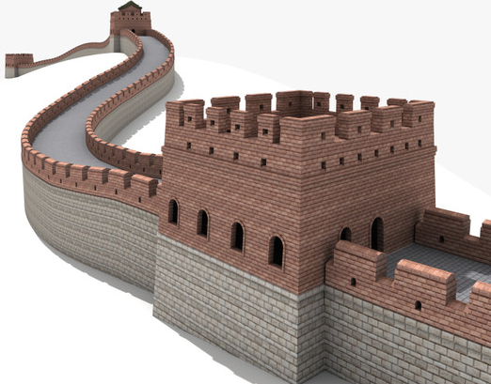
London, England
Big Ben
Pisa, Italy
Leaning Tower of Pisa
Paris, France
Eiffel Tower
New York Harbor, U.S.
Statue of Liberty
The Great Wall of China
It was the most exciting thing traveling high in the air through the sky. I could see everything around the world.
See The World
E
N
D

Slide 5
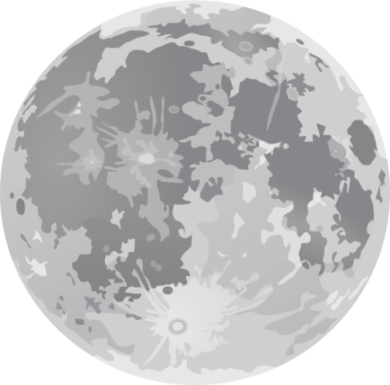
The stars sparkled so bright as we flew through the night.
Night Flight
E
N
D

Slide 6
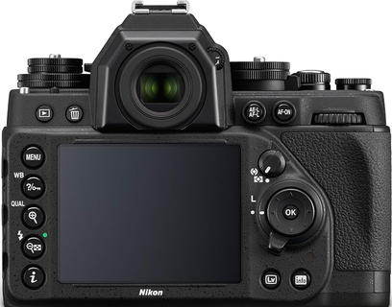
We landed our hot air balloon in the highest mountains in the world to take a picture. Quite a site!
Take Your
Picture
E
N
D
E
N
D
Take a Picture
E
N
D

Slide 7
E
N
D
E
N
D
E
N
D

Slide 8
I cannot wait to go on another Hot Air Balloon Trip!!
We’re Safely Home
Land The
Balloon
E
N
D

Slide 9
The Great Balloon Ride
E
N
D

Slide 10
See Your
Picture
E
N
D
E
N
D
E
N
D

